Slide 1
Lecture 1 Introduction to Mobile Computing
Reference
“MOBILE COMPUTING PRINCIPLES, DESIGNING AND DEVELOPING
MOBILE APPLICATIONS WITH UML AND XML”, REZA B’FAR

Slide 2
Contents
1. Introduction
2. Dimensions of Mobile Computing
3. Condition of the Mobile User
4. Architecture of Mobile Software Applications

Slide 3
Introduction
Mobile computing systems are computing systems that may be easily moved physically
and whose computing capabilities may be used while they are being moved
Examples :
laptops, personal digital assistants (PDAs), and mobile phones

Slide 4
Mobile App. Puzzle
Mobile computing system
Mobile user
Mobile device
Mobile application
Mobile network

Slide 5
Why mobile computing?
Mobile computing system can do set of properties a stationary computing system can’t do
mobility includes:
- moving between different geographical locations
- moving between different networks
- moving between different applications

Slide 6
Advantages of mobile computing systems:
Prevalent wireless network connectivity
Small size
The mobility nature of their use
Power sources
Their functionalities that are particularly suited to the mobile user.

Slide 7
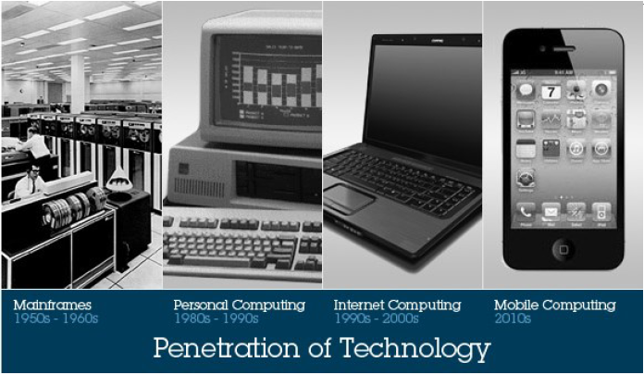
Brief History

Slide 8
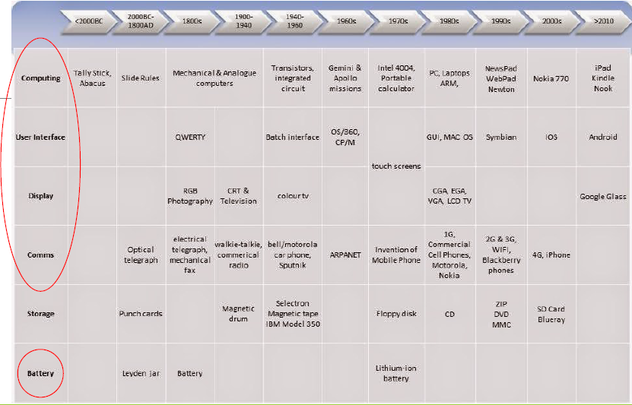
Brief History

Slide 9
Is wireless mobile ?
Or
Is mobile wireless ?

Slide 10
2- Dimensions of mobility
dimensions of mobility are the tools that allow us to qualify our problem of building mobile software applications and mobile computing systems.
Dimensions of mobility are not completely orthogonal with respect to each other.
Some of these dimensions are limitations

Slide 11
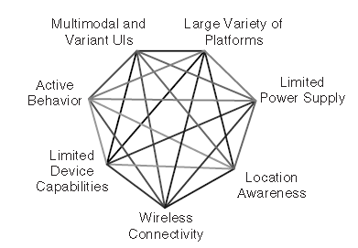
continued

Slide 12
2.1 Location awareness
acquiring position information requires connectivity to some network-based infrastructure.
localization
location sensitivity
challenges and opportunities

Slide 13
continued
Methods for collecting and using the location of the user and the device
user may simply be prompted for his or her location (user unfriendly)
Location-sensing technology
Triangulation
proximity
scene analysis

Slide 14
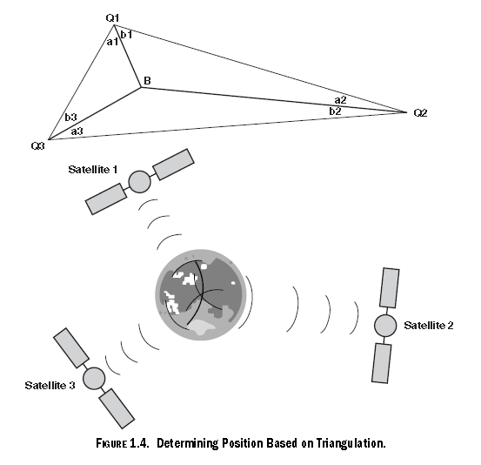
continued
Triangulation

Slide 15
continued
Proximity-based methods measure the relative position of the unknown point to some known point.
Scene analysis method relies on image processing and topographical techniques to calculate the location of the unknown point based on a view of the unknown point from a known point

Slide 16
2.2 Quality of Service (QoS)
Moving from one physical location to another may cause some disconnected time from the network
The quality and type of the available network connectivity can significantly affect QoS
network connectivity and QOS need to be taken into account while designing a mobile application

Slide 17
continued
QoS:
Available bandwidth
Probability of connectivity
Statistical traffic measurements

Slide 18
continued
All mobile applications should know how to stop working when the application suddenly
disconnects from the network and then
resume working when it connects again
QoS is provided by the network operator.
Designing applications should dynamically adapt their features and functionality to the available bandwidth

Slide 19
2.3 Limited Device Storage and CPU
Size and Portability
&
Size and performance

Slide 20
continued
Smaller physical size limitation imposes boundaries on volatile storage, nonvolatile
storage, and CPU on mobile devices
when it comes to mobile systems and devices, smaller is nearly always better.

Slide 21
2.4 Limited Power Supply
The power supply has a direct or an indirect effect on everything in a mobile device.
Challenges:
Battery life
Mobility effect on battery life
Connectivity effect on battery life
Battery management
OS or App job?

Slide 22
continued
Platforms should provide:
monitoring of the remaining power and other related power information.
allow multiprocessing and multithreading
which have an effect on the control over the variation of the CPU activity, which in turn has an effect on the control over the power consumed by the device.

Slide 23
2.5 Varying User Interfaces
Stationary application users have more efficient user interface capabilities than mobile application users
Multichannel systems
This is not true for all application
The challenge is how to choose the best UI for the context

Slide 24
continued
User interfaces are difficult to design and implement for the following reasons:
1. Designers have difficulties learning the user’s tasks.
2. The tasks and domains are complex.
3. A balance must be achieved among the many different design aspects.
4. The existing theories and guidelines are not sufficient.
5. Iterative design is difficult.
6. There are real-time requirements for handling input events.
7. It is difficult to test user interface software.
8. Today’s languages do not provide support for user interfaces.
9. Programmers report an added difficulty of modularization of user interface software.

Slide 25
2.6 Platform Proliferation
Due to commercial competence in the world of mobile devices, every manufacture has his own platform proliferation (android vs ios)
It affects the device supported-applications
Platform proliferation heighten the importance of designing and developing mobile devices independent of the platforms
UML based design

Slide 26
2.7 Active Transactions
Passive transaction
Active transaction
synchronous
asynchronous

Slide 27
3- CONDITION OF THE MOBILE USER
Changing Location
Lack of Focus
The primary focus of the mobile
Immediacy
Abrupt Changes in Tasks
Anywhere, Anytime

Slide 28
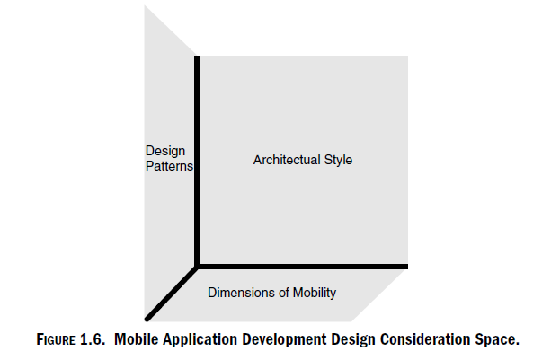
4- ARCHITECTURE OF MOBILE SOFTWARE APPLICATIONS

Slide 29
Thanks- Questions !

